Slide 1
What is Micro-FrontEnds
An architectural style where independently deliverable frontend applications are composed into a greater whole ^{[1]}
Inspired by Microservices Architecture, the main idea behind Micro Frontends is to break down “the Front End Monolith” into smaller parts, allowing an organization to spread the amount of work with autonomous teams, co-located or distributed, without the need to slowing down their delivery throughput^{[2]}
The Micro Frontend approach tackles the monolithic frontend issues by extending the principles of Microservices to frontend development. Instead of dividing the application’s architecture into frontend and backend, the application itself is divided into multiple independent pieces — from the backend service and database right up to the user interface — and then merged into a single user-facing frontend^{[3]}
Notes:
Thoughtworks: https://martinfowler.com/articles/micro-frontends.html#:~:text=In%20short%2C%20micro%20frontends%20are,about%20the%20dependencies%20between%20them.
Building Micro-Frontends by Luca Mezzalira
Paypal Engineering: https://medium.com/paypal-engineering/how-micro-frontend-has-changed-our-team-dynamic-ba2f01597f48

Slide 2
Micro-FrontEnds | Key Tenets
An architectural style where independently deliverable frontend applications are composed into a greater whole ^{[1]}
Inspired by Microservices Architecture, the main idea behind Micro Frontends is to break down “the Front End Monolith” into smaller parts, allowing an organization to spread the amount of work with autonomous teams, co-located or distributed, without the need to slowing down their delivery throughput^{[2]}
The Micro Frontend approach tackles the monolithic frontend issues by extending the principles of Microservices to frontend development. Instead of dividing the application’s architecture into frontend and backend, the application itself is divided into multiple independent pieces — from the backend service and database right up to the user interface — and then merged into a single user-facing frontend^{[3]}
Notes:
Thoughtworks: https://martinfowler.com/articles/micro-frontends.html#:~:text=In%20short%2C%20micro%20frontends%20are,about%20the%20dependencies%20between%20them.
Building Micro-Frontends by Luca Mezzalira
Paypal Engineering: https://medium.com/paypal-engineering/how-micro-frontend-has-changed-our-team-dynamic-ba2f01597f48

Slide 3
Identifying MicroFrontEnds

Slide 4
How To Build MicrofrontEnds
Notes:
https://frontconf.com/talks/21-03-2020/micro-frontends-the-good-the-bad-and-the-ugly/

Slide 5
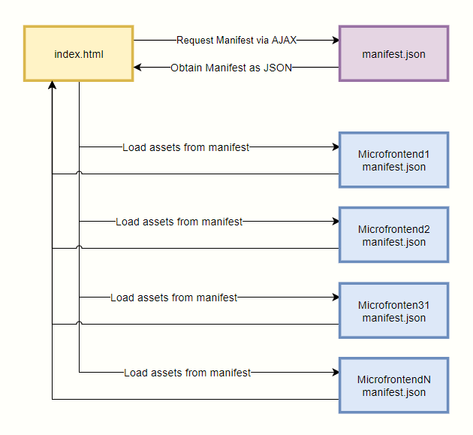
MFD: Versioning
Notes:
Google MonoRepos

Slide 6
MFD: Stitching Layer
Notes:
https://medium.embengineering.com/micro-front-ends-and-manifest-automation-2988a22e8941

Slide 7
MFD: Communication Layer
Notes:
https://www.npmjs.com/package/broadcast-channel

Slide 8
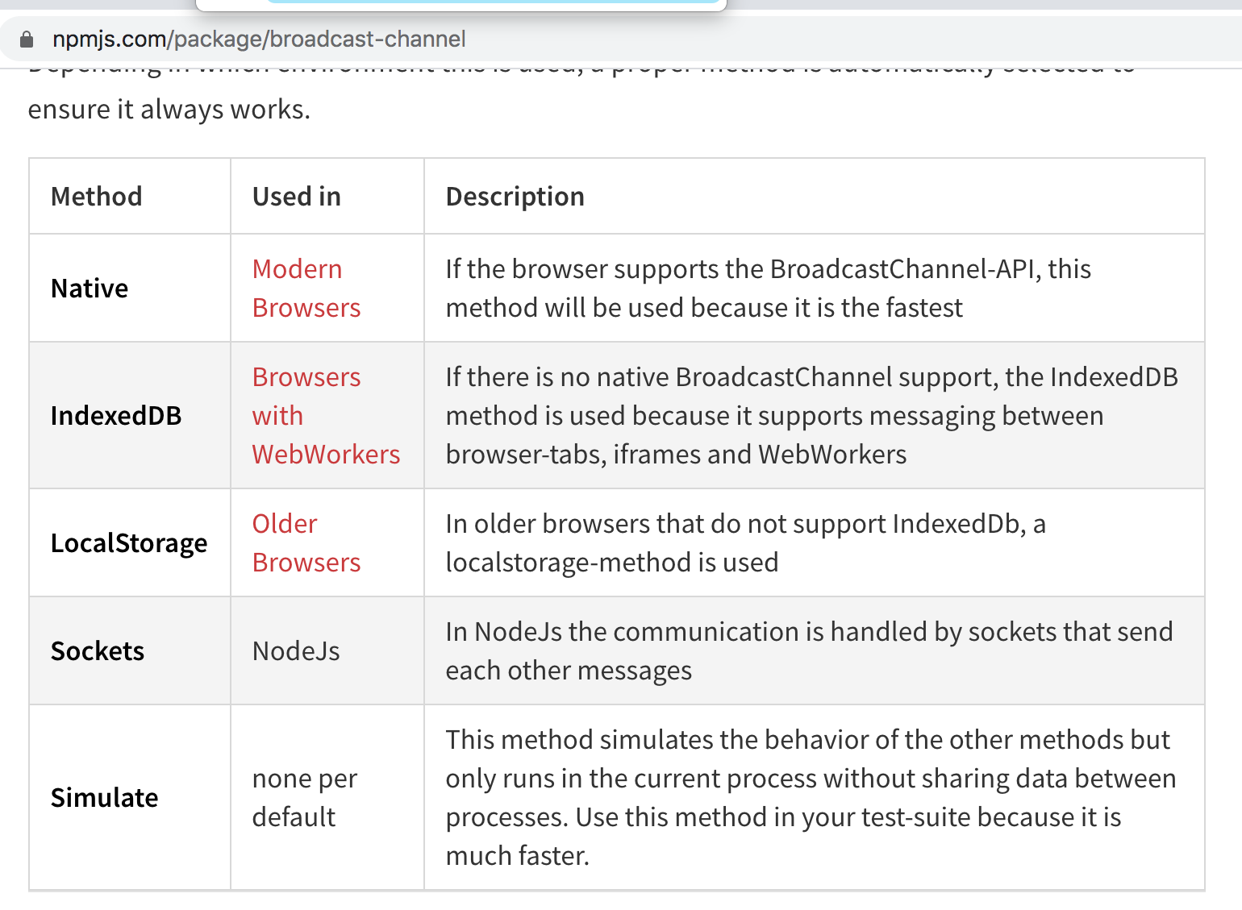
MFD: Communication
Client Side –

Slide 9
MFD: Routing

Slide 10
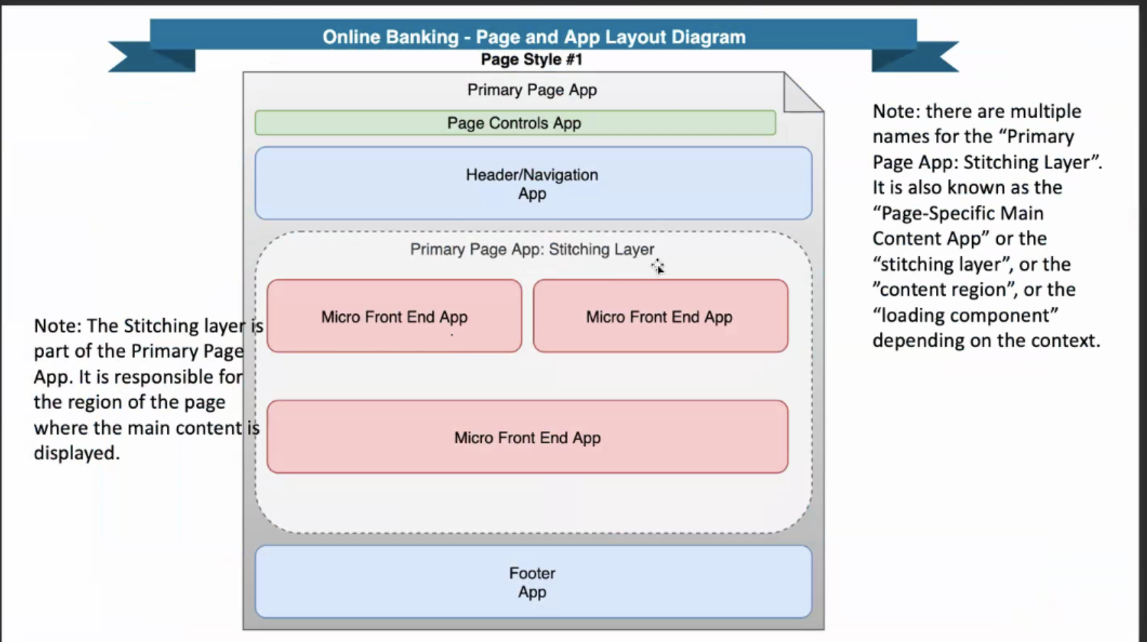
Case Study 1
Technology Stack:
FrontEnd: JS ES6, ReactJS, NextJS, GraphQL
SS: NginX, NodeJS
API gateway: APIGEE
CI/CD: Jenkins
Static Assets: Akamai
Deployment: Rancher/Docker
Business (LoB): B2C consumer banking
Markets: US only
MFDs:
Bill Pay
Wire Transfer
ACH transfer
Manage Transactions
Profile Management
Dashboard
Authorization & Authentication –
OTP Flow,
EWS Check Feature – For fraudulent Txn check

Slide 11
Case Study 1
Technology Stack:
FrontEnd: JS ES6, ReactJS, NextJS, GraphQL
SS: NginX, NodeJS
API gateway: APIGEE
CI/CD: Jenkins
Static Assets: Akamai
Deployment: Rancher/Docker
Business (LoB): B2C consumer banking
Markets: US only
Composition Approach: Client Side, Custom HTML Elements
MFDs:
Bill Pay - <xxx-bill-pay> - App Name & Version in manifest file
Wire Transfer
ACH transfer
Manage Transactions
Profile Management
Dashboard
Authorization & Authentication –
OTP Flow,
EWS Check Feature – For fraudulent Txn check
Notes:
ATM, Teller Machines, Web Borwsers etc.

Slide 12
Instant Verification
Biz Info
Page
Personal Info
GCAP
Dynamic Questions
Yodlee Widget
Decision Page
Balance transfer
Add Supplementary
Add Business Owner

